Slide 1




Slide 2

Presenters Name
N.Nikhil

Slide 3

4
INTRODUCTION
97% for you
13+
2024
This activity simulates the process of designing a software architecture for a NETFLIX application. You'll identify critical requirements, explore tactics to address them, and visualize the system's structure using diagrams.
Skip

Slide 4
NEtflix
4
Top 3 ASRs at Netflix
The top 3 Architecturally Significant Requirements (ASRs) chosen for Netflix (High Availability, Scalability, and Performance) are crucial because they directly impact the user experience and the overall viability of the service.
While other ASRs are also important. But High Availability, Scalability, and Performance are most critical for Netflix to function effectively and deliver a smooth user experience. The choice of ASRs is driven by the specific needs and priorities of the application.
1 2 3
High Availability
Scalability
Performance

Slide 5


Slide 6
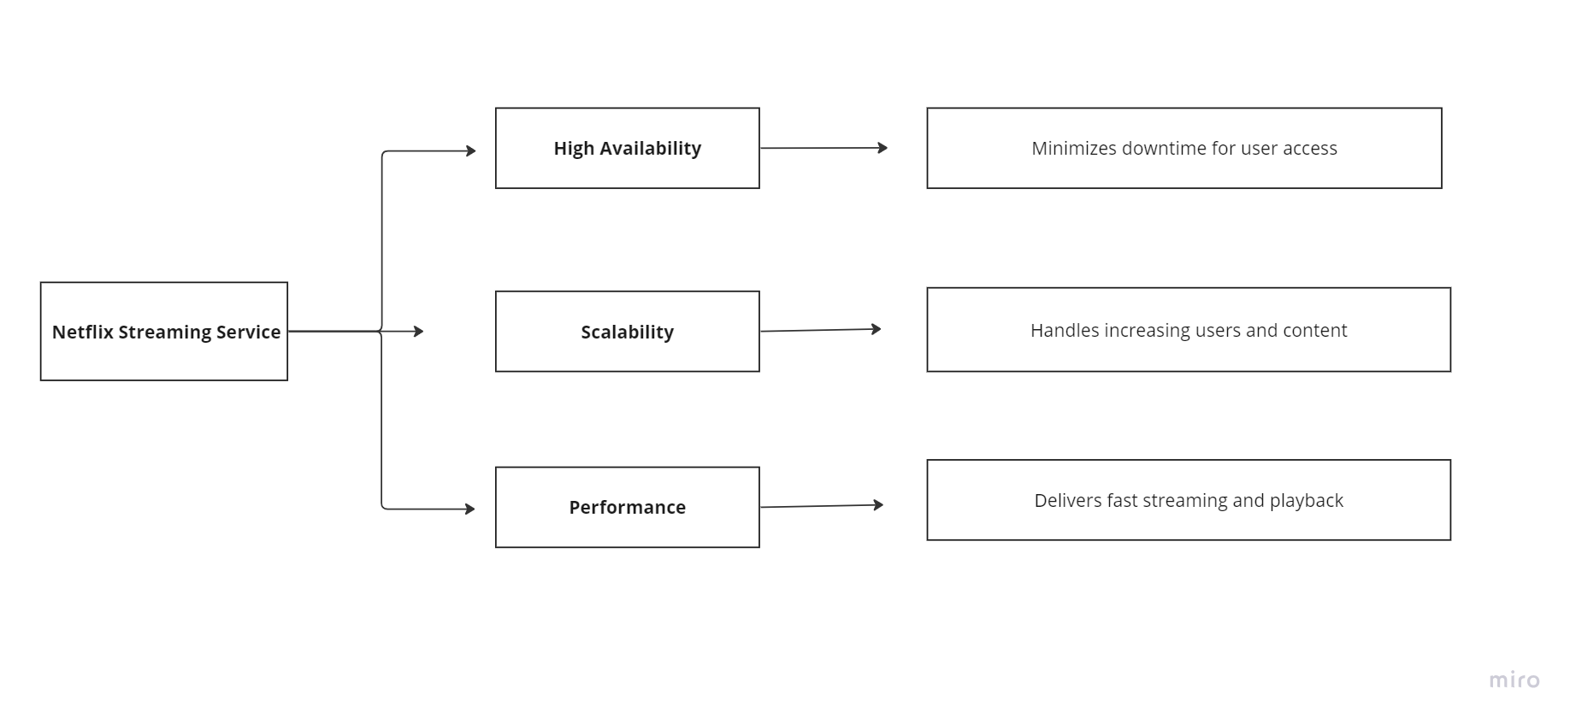
UTILITY TREE
97% for you
13+
2024
A utility tree can help visualize how these ASRs contribute to the overall goal of the Netflix .
Play

Slide 7
High Availability:
Tactics:
Microservices Architecture:
Break down the system into independent, loosely coupled services. This allows individual services to be restarted or scaled without affecting the entire platform.
Redundancy:
Implement redundant components across infrastructure layers. This includes having multiple servers, databases, and network connections. If one component fails, another can take over seamlessly.
Load Balancing:
Distribute incoming traffic across multiple servers to prevent overloading any single instance. This ensures service availability even during peak usage periods.
Disaster Recovery (DR):
Implement a DR plan to recover quickly from larger outages or infrastructure failures. This might involve geographically dispersed data centers or cloud-based backup solutions.
Skip

Slide 8
2. Scalability:
Tactics:
Cloud Infrastructure:
Utilize cloud platforms like AWS, Azure, or Google Cloud Platform (GCP) to easily provision and scale resources on-demand. Cloud providers offer elastic resources that can be automatically scaled up or down based on user traffic.
Horizontal Scaling:
Scale services horizontally by adding more instances of a service to handle increased load. This is particularly effective for stateless services like content delivery.
Content Delivery Network (CDN):
Distribute content across geographically dispersed servers to reduce latency for users. CDNs cache frequently accessed content closer to users, minimizing the distance data needs to travel.
Database Sharding:
Distribute data across multiple databases to improve query performance and handle increased data volume.
Skip

Slide 9
3. Performance:
Tactics:
Caching:
Cache frequently accessed data (e.g., user profiles, thumbnails, frequently streamed content) to reduce database load and improve response times.
Content Encoding:
Deliver content in optimized formats for different devices and network conditions. This might involve using adaptive bitrate streaming, which adjusts video quality based on available bandwidth.
Database Optimization:
Optimize database queries and schema design to minimize retrieval times.
API Gateway:
Implement an API Gateway as a single entry point for API calls. This can handle load balancing, caching, and traffic management, improving overall system performance.
Skip

Slide 10
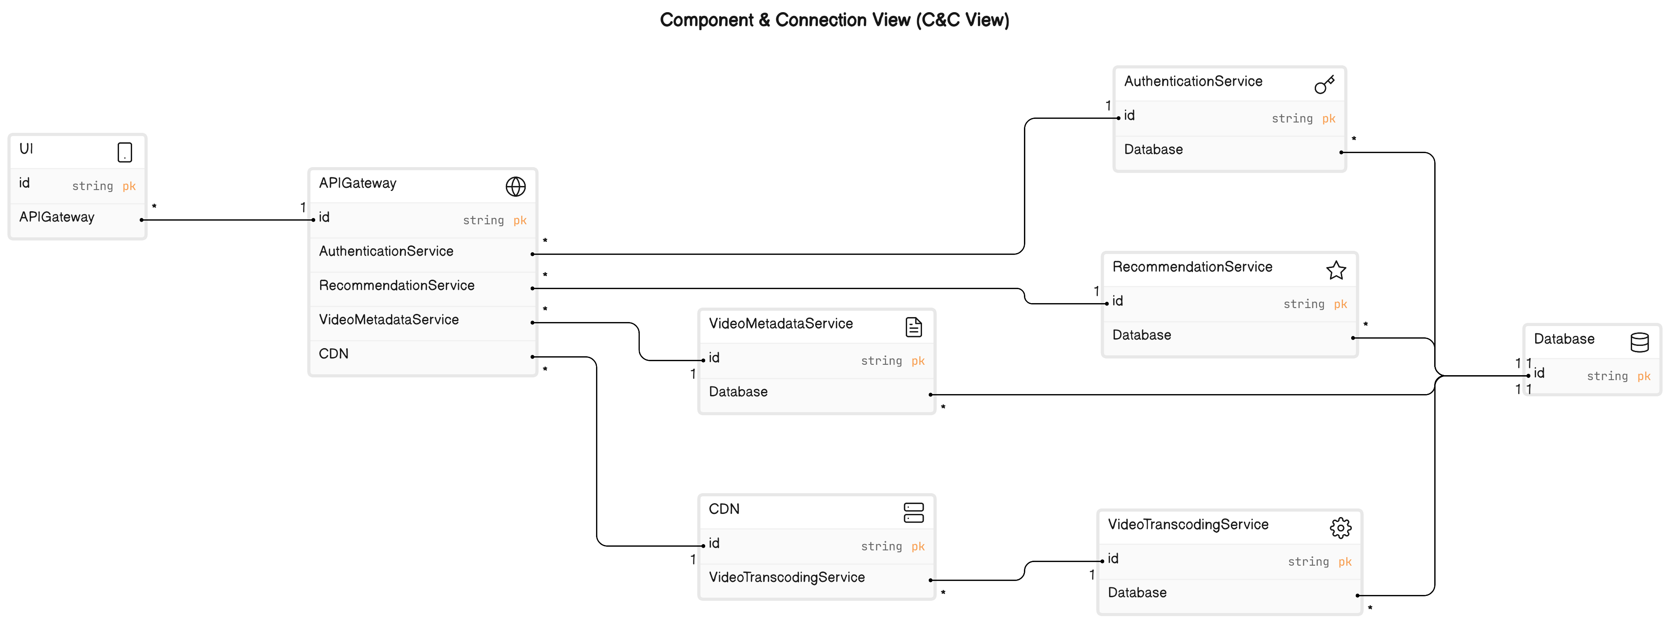

Slide 11
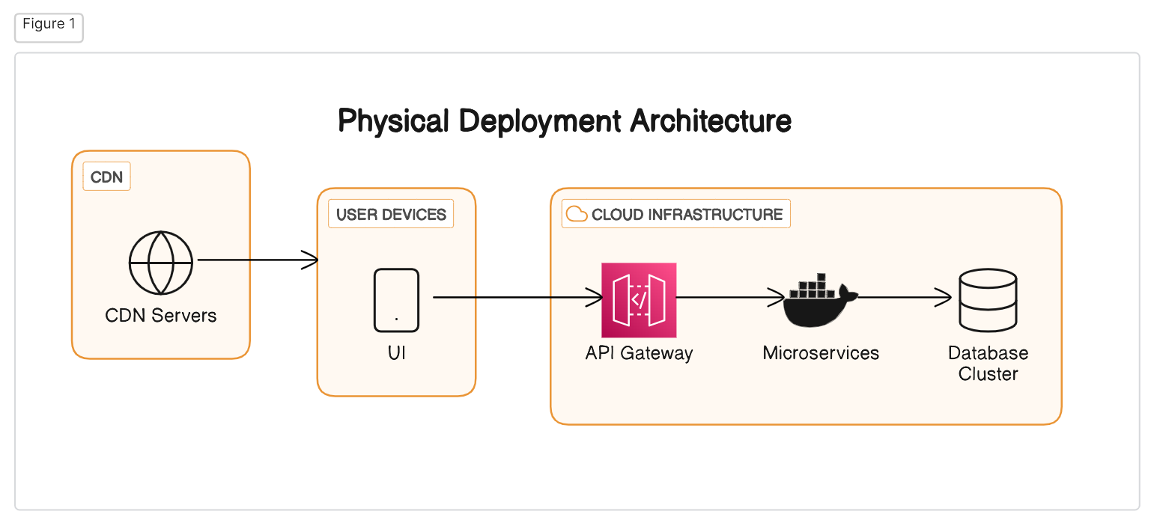
Skip

Slide 12
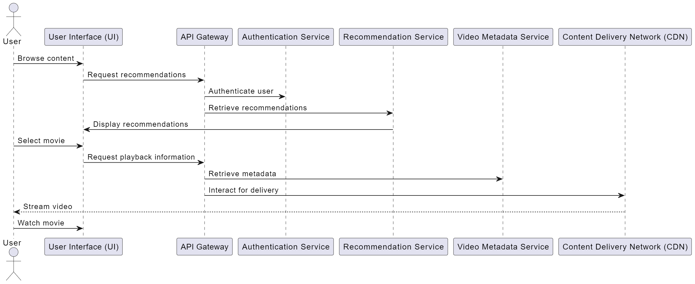
Sequence Diagram
Skip

Slide 13
Architecture Patterns in Netflix :
1. Microservices Architecture:
Explanation: The system is broken down into independent, loosely coupled services. Each service has a specific responsibility (e.g., authentication, recommendations, video metadata) and can be developed, deployed, and scaled independently.
Where Used: This pattern is applied throughout the system. Components like Recommendation Service, Video Metadata Service, and Video Transcoding Service are all implemented as microservices.
2. API Gateway:
Explanation: A single entry point for all API calls into the system. It handles traffic routing, security (e.g., authentication), and load balancing.
Where Used: The API Gateway sits in front of the microservices, acting as the primary interface for user requests and external applications.
Skip

Slide 14
3. Content Delivery Network (CDN):
Explanation: A geographically distributed network of servers that cache and deliver content to users. This reduces latency and improves content delivery performance.
Where Used: The CDN plays a crucial role in streaming video content. It caches frequently accessed content closer to users, minimizing the distance data needs to travel.
4. Cloud Infrastructure:
Explanation: Leveraging cloud platforms like AWS, Azure, or GCP provides on-demand scalability and elasticity. Resources can be easily provisioned and scaled up or down based on user demand.
Where Used: The entire system, including microservices, databases, and the API Gateway, can be deployed on cloud infrastructure for scalability and flexibility.
Skip

Slide 15
KEY LEARNINGS :
1. Identifying Critical ASRs Drives Design Decisions:
The first step is understanding the most critical aspects of the system, captured in Architecturally Significant Requirements (ASRs).
For Netflix, these were High Availability, Scalability, and Performance.
Identifying these ASRs early on guides the selection of tactics and architectural patterns for the entire system.
2. Tactics Tailor to ASRs for Optimal Performance:
Once ASRs are defined, we can choose appropriate tactics to address them.
Examples include Microservices Architecture for Scalability, Redundancy for High Availability, and Caching for Performance.
The chosen tactics work together to ensure the system meets its core functional and non-functional requirements.
3. Visualizations Aid Communication and Understanding:
Diagramming the architecture is essential for clear communication and collaboration.
We used Component & Connection View and Deployment View diagrams to showcase how components interact and how the system is physically deployed.
Sequence diagrams further illustrate how specific user scenarios translate into interactions between system components.
Skip

Slide 16
thanks

